Slide 1
L’Assurance inclusive et la numérisation
Groupe des Contrôleurs d’Assurance Francophones |
31 Janvier 2024 | Pascale Lamb
Notes:
Overview of emerging technologies & innovations in the insurance space
Focus on Big Data, Advanced analytics, IoT for telematics and monitoring, AI & Machine Learning and Blockchain
The role of emerging technologies in risk assessment and management
Index Insurance / Parametric insurance
Mobile technology and microinsurance
P2P Insurance platforms
On demand insurance solutions
Benefits of Adopting Emerging Technologies
increased accuracy and precision
enhanced consumer experience
faster claims processing /settlement
greater outreach to underserved markets
Challenges & Risks
Regulatory Challenges (data privacy and security issues)
Technology Adoption Barriers - affordability and accessibility issues (digital divide)
Capacity Building on emerging technologies
A2ii Resources / Connect.a2ii
QR Code survey on supervisory needs on technology

Slide 2
1| Introduction
2 L'évaluation et la gestion des risques
3| Les Avantages, défis et risques
4| Ressources A2ii pour les contrôleurs

Slide 3
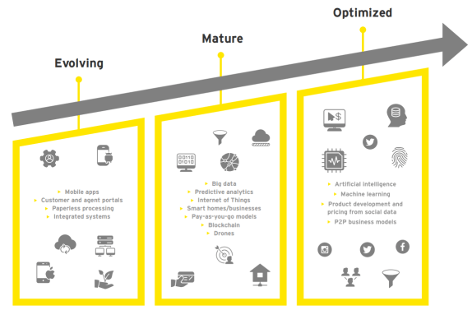
Introduction | numérisation
Gamification & Social Media
Usage-based insurance
Peer to Peer
Robo advice
IoT
Big Data / Machine Learning
Blockchain / DLT
SaaS
Notes:
So what are some of the emerging technologies that we are seeing in the insurance sector – as you can see from this slide they are wide ranging so for the sake of time, I will focus on the trends that are the most significant from a consumer and inclusive insurance perspective.
One of the most significant trends is the use of data analytics and artificial intelligence (AI) in insurance.
Insurers are using data analytics to better understand their customers and their risk profiles.
Through the use of big data, insurance companies can gain insights into customer behavior, trends, and patterns, and use this information to create personalized policies that meet the specific needs of their customers.
Blockchain technology is also being used to improve transparency and reduce fraud. Blockchain enables insurers to create secure, tamper-proof records of transactions, which can be accessed by all parties involved in the insurance process. This helps to reduce disputes and ensures that claims are processed quickly and fairly.
Finally, the rise of the Internet of Things (IoT) is also having a significant impact as they are generating large amounts of data that can be used to create more personalized insurance products. For example, insurers can use data from a telematics box in a car to create usage-based auto insurance policies that are tailored to the specific driving behavior of each individual customer.
I will come back to these technologies later in my presentation but for now I want to quickly highlight
.

Slide 4
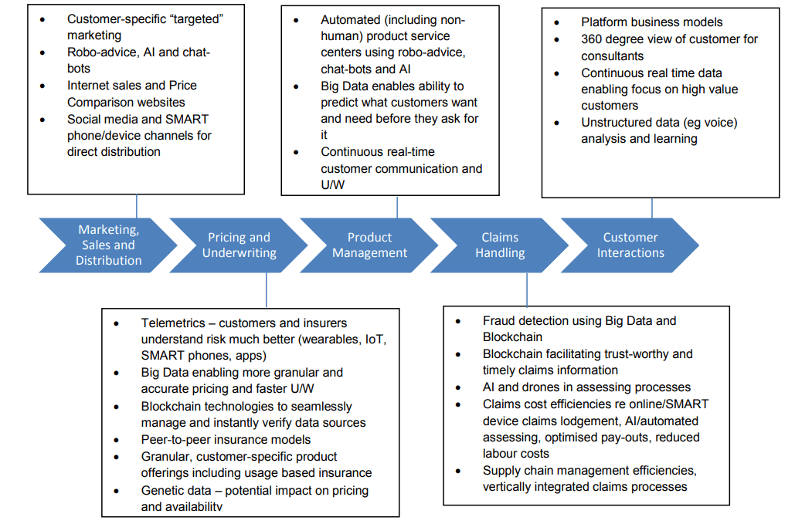
Introduction | Le cycle de vie
Digitalisation throughout the insurance value chain
Notes:
And as you can see from this slide – taken from the IAIS’s 2018 Digitalization paper - These tech trends are being applied throughout the insurance value chain from the design and underwriting to the pricing of products, their marketing and distribution, through to claims processing and the ongoing management of customer relationships.
numérisation can be applied throughout the insurance value chain but it’s not always the case – and for this reason I want to highlight another emerging trend in insurance……(GO TO NEXT SLIDE)
LINK TO IAIS PAPER: https://www.iaisweb.org/uploads/2022/01/181112-Issues-Paper-on-Increasing-Digitalisation-in-Insurance-and-its-Potential-Impact-on-Consumer-Outcomes.pdf – link to the paper.

Slide 5
Introduction | Les InsurTechs
"variété de technologies émergentes et de modèles commerciaux innovants qui ont le potentiel de transformer l'activité d'assurance". L’AICA, Développements FinTech dans le secteur de l'assurance, 2017.
 | InsurTechs vs Incumbents Une connectivité accrue Les produits s'adressent à des consommateurs spécifiques Automatisation complète Les produits sont pilotés par les données
Notes:
And that is the rise of InsurTechs
The IAIS defines insurtechs as a “variety of emerging technologies and innovative business modesl that have the potential to transform the insurance business”
These are companies that are using technology to disrupt traditional insurance models and provide new products and services to customers.
In particular InsurTechs are leveraging technology to streamline the insurance process, reduce costs, and create new revenue streams.
According to McInsey the Asia-Pacific regions accounts for 14% of insurtechs globally and this region is actually expected to be the fastest growing in the next few years.
The clear advantage for insurtechs is that they are able to go to market in fundamentally different ways than incumbents can.
One advantage insurtechs exploit is their freedom from legacy products, processes, and IT systems. They are able to design digital processes, products, and systems from the ground up, relying on the latest technology.
They also use their digital expertise to maximize value in a number of ways.
Increased connectivity. Insurtechs using AI and bots to provide robo-advice through a digital customer interface with digital distribution.
Targeted product concepts. Insurtechs are able to offer personalized small ticket products based on usage or value-added services.
Full automation. By an automated only approach, insurtechs cut costs and accelerate processes to meet customer expectations.
Data-driven decision making and insights. With access to diverse sources of data, including telematics and smartphone apps, insurtechs are applying machine-learning techniques to offer innovative, personalized products and services.

Slide 6
1| Introduction
2 L'évaluation et la gestion des risques
3| Les Avantages, défis et risques
4| Ressources A2ii pour les contrôleurs

Slide 7
Évaluation des Risques
Intelligence artificielle et apprentissage automatique
L'analyse du Big Data
Internet des objets
Blockchain
Notes:
As innovation is occurring throughout the insurance life cycle, it’s perhaps unsurprising then that it’s also reshaping the landscape of insurance risk assessment, making it more accurate, efficient, and customer-centric.
Let's explore some key ways in which innovation is being harnessed in this crucial aspect of the insurance industry:
Artificial Intelligence (AI) and Machine Learning: AI-powered algorithms analyze vast datasets to predict risk more accurately. For instance, insurers can use AI to assess a client's risk profile by considering their lifestyle, health data, and other factors. With the help of machine learning algorithms, insurers can create highly personalized risk profiles for customers. This means your insurance premium is not just based on general statistics but on your specific behavior, lifestyle, and circumstances, resulting in fairer pricing.
Big Data Analytics: Big data technologies help insurers process and analyze large volumes of information quickly. They can tap into external data sources such as weather patterns, social media behavior, and credit scores to refine their risk assessments. It also means insurers can now analyze not only traditional data but also non-traditional sources like social media, IoT devices, and satellite imagery to gain deeper insights into risk factors.
Internet of Things (IoT): IoT devices like telematic sensors in cars or wearable health trackers provide real-time data that can be used for risk assessment. This data is then used to determine auto insurance premiums, encouraging safer driving habits and reducing risks on the road.
Blockchain: Blockchain enhances transparency and trust in insurance contracts. Smart contracts on the blockchain can automate claims processing and reduce fraud, ensuring a fairer and more efficient claims settlement process.

Slide 8
Gestion des Risques
L'assurance paramétrique
La télématique
L'analyse prédictive
Plateformes de micro-assurance
Notes:
To give more perspective on how this technology is being applied ;
Parametric Insurance: Parametric insurance pays out automatically when predefined triggers are met, such as a certain level of rainfall or earthquake magnitude. This speeds up claims processing and provides faster relief to policyholders, particularly in disaster-prone regions.
Telematics: Telematics devices in vehicles collect data on driving behavior, allowing insurers to offer personalized pricing based on how safely a person drives. This encourages safer driving and reduces the overall risk for insurers.
Predictive Analytics: Predictive analytics leverages historical data and machine learning to forecast future risks accurately. Insurers can identify trends and anticipate potential losses, leading to more proactive risk management strategies.
Microinsurance Platforms: Digital platforms enable the creation and distribution of microinsurance products to underserved populations. These platforms reduce administrative costs, making insurance more affordable and accessible to low-income individuals.

Slide 9
#Innovation
Le document présente les meilleures pratiques de différents marchés à travers le monde, avec un accent particulier sur les 10 pays insulaires du Pacifique.
Inclut les meilleures pratiques pour les régulateurs d'assurance, les décideurs politiques et le secteur.
Encourager l'entrée des produits d'assurance indicielle sur le marché : approbations conditionnelles et sandboxing.
NOUVEAU DOCUMENT :
LES MEILLEURES PRATIQUES EN MATIÈRE D'ASSURANCE INDICIELLE POUR LES RÉGULATEURS ET LES PRATICIENS DE L'ASSURANCE DANS LES PAYS INSULAIRES DU PACIFIQUE

Slide 10
1| Introduction
2 L'évaluation et la gestion des risques
3| Les Avantages, défis et risques
4| Ressources A2ii pour les contrôleurs

Slide 11
Les Avantages | Les assureurs
Plus d'efficacité
Coûts réduits
Amélioration de la gestion des risque
Des prix exacts
Avantage compétitif
Meilleure variété de produits
Rendre visible un produit non visible
Meilleure communication avec les consommateurs
Notes:
The overall impact on the industry is that it has made insurance more efficient and cost effective. By automating many of the processes involved in underwriting, claims processing and policy administration, insurers can reduce their costs and improve their bottom line. This in turn allows them to offer more competitive prices to their customers. But also as I mentioned earlier by using technology to collect more accurate data and improve risk management, this has entailed more accurate pricing – index insurance for example has allowed products to be accessible that in the past were not viable.
Also quite critically, traditionally insurance has not had a lot of interaction with customers especially post sale – and with digitalisation that is changing and increasingly the sector is becoming more customer centric.
More efficient service delivery lowers costs
Better delivery helps attract and retain customers
Risk mitigation support to clients reduces claims costs
Better risk information allows better risk selection, pricing, and risk management
Some product options become feasible that were not before
Back-office efficiency gains can flow straight to the bottom line
Fraud can be detected and reduced
A smarter business becomes a competitive advantage

Slide 12
Les Avatantages | Les consommateurs
Accès plus facile à l'assurance
Produits d'assurance personnalisés
Plus de flexibilité
Des coûts moins élevés
Une meilleure expérience pour le consommateur
Augmentation de la confiance des consommateurs
Une assurance accessible
Amélioration de l'inclusion financière des personnes exclues
Notes:
This leads me quite nicely onto my next slide because perhaps certainaly from an inclusive insurance perspective one of the key advatantages of digitalization is that is has made insurance more accessible to customers. By using digital channel s customers can purchase insurance products and services more easily and quickly than ever before´. They can also access information about their policies, make claims and track the status of their claims. This generally improves the consumer experience with insurance. This greater transaprency builds consumer confidence and a greater understanding of how insurance works.
Easier to get the insurance you need at the right time
Products are more customized to your situation, so you don’t pay for what you don’t need
Easier to make payments, submit claims, and get customer service issues handled
More cost-effective delivery lowers costs
Rewards for lower-risk behavior lower costs
Value-added services
Potential personal automation

Slide 13
Les Avantages | Le contrôleur
La détresse financière
Les interconnexions financières
L'analyse des données
Analyse et gestion des risques
Détection et prévention des fraudes
Contrôle des transactions
SupTech
Cette technologie des autorités de contrôle est un sous-ensemble des FinTech qui utilise une approche technologique innovante pour appuyer le travail de contrôle.
RegTech
Se concentre sur les technologies susceptibles de faciliter une mise en œuvre plus efficace et efficiente des exigences réglementaires que ce qui est possible actuellement
Notes:
Cette technologie des autorités de contrôle est un sous-ensemble des FinTech qui utilise une approche technologique innovante pour appuyer le travail de contrôle. Elle aide les agences de contrôle à numériser les processus de reporting et de réglementation, ce qui permet d’assurer de manière plus efficace et proactive l’évaluation des risques et de la conformité des institutions financière
La technologie en matière de réglementation est un sous-ensemble de technologies financières qui se concentre sur les technologies susceptibles de faciliter une mise en œuvre plus efficace et efficiente des exigences réglementaires que ce qui est possible actuellement
I also think it’s important to highlight that innpvation and emerging technologies has also had an impact on supervisors and regulators
Firstly, Supervisors have been engaging with technology to support their own work through Supervisory Technology. This involves developing tools to assist them in their prudential and market conduct mandates. Examples include tools to identify financial distress in their respective market and to be better understand the intereconnectness between the insurance sector and the wider financial system. From a conduct perspective some of the tools being developed are focusing on Natural Language Processing to analyse data and automated transcription of telemarketing activities to identify mis-selling.
Meanwhile with Regulatory technology – while these are solutions being developed by industry that supports supervisors in ensuring that regulated entities comply with the authorities regulations.
Secondly the impact of digitalization on supervisors which is not included on this slide is the impact of digitalization on regulatory and supervisory frameworks. As I’ve outlined previously, whilst digitalisation entails the introduction of new methods, ideas or products that offer greater efficiency However, it brings with it consumer and systemic risks and, due to its novel nature, is often not fully accommodated in current regulatory frameworks. Indeed, innovation may challenge the very nature of insurance and other financial services. This confronts regulators with the need to facilitate and promote innovation, while protecting consumers and adequately managing the risks that arise.

Slide 14
La numérisation | Risque réglementaire
Des cadres réglementaires insuffisants
La protection des consommateurs
La protection des données
risques de cybersécurité
Risques de cybersécurité
Des progrès technologiques rapides
Le manque d'expertise et de connaissances
Notes:
With innovation, regulatory risk unfortunately is not just confined to index insurance though there are recurring themes that we keep hearing about across the regions;
As I’ve just mentioned Innovation often challenges existing regulatory frameworks and adjustments often need to be made to ensure effective oversight and consumer protection.
Also, while innovation can enhance customer experiences and financial inclusion it can present consumer protection risks and innovative practices should not compromise consumer rights or result in unfair treatment or discrimination.
Linked to this is the increasing use of technology and data-driven processes - the collection, storage, and use of sensitive customer information become critical
With this as well Insurance companies are becoming attractive targets for cybercriminals due to the vast amount of personal and financial data they possess
Another challenge that we keep hearing is that supervisor can struggle to keep up with the rapid pace of technology advancements – the rapid evolution may often outpace the expertise and knowledge of regulators and supervisors as well - making it challenging to assess risk accurately which can lead to regulatory arbitrage
With innovation transcending national boundaries, regulators and supervisors face challenges in achieving international coordination and harmonization of regulatory approaches. Collaboration among regulatory bodies is crucial to address cross-border risks effectively – it's why Forum’s like the IAIS’s Fintech Forum is so invaluable as it enables peer exchanges and a sharing of best practice.

Slide 15
Innovation | Regulatory Responses
les bacs à sable réglementaires
Les laboratoires d'innovation
Amélioration des procédures d'autorisation et d'approbation
Lignes directrices et cadres axés sur la technologie
Éducation et protection des consommateurs
Notes:
To confront these risks, Asian supervisors have responded to digital innovation with a range of regulatory measures, including regulatory sandboxes, technology-focused frameworks, and enhanced collaboration.
These responses foster innovation, protect consumer interests, and creates an enabling environment that ensures a resilient and dynamic insurance sector in the digital age.
Subsequently we’ve seen the emergence of regulatory sandboxes, innovation labs, enhanced licensing and approval processes tp Streamlining procedures and providing dedicated channels for digital insurance applicants encourage innovation while maintaining regulatory oversight
Supervisors have developed guidelines and frameworks that address specific technology areas, such as AI, IoT, and blockchain, to ensure responsible and ethical use
And lastly consumer education and protection – Initiatives here include promoting transparency, ensuring fair practices, and raising awareness about potential risks associated with digital insurance products.
regulators and supervisors have responded by adopting a range of regulatory measures both to address emerging risks and ensure consumer protection
Introduction:
As the insurance industry experiences rapid digital innovation, Asian supervisors have responded by adopting regulatory measures to address emerging risks and ensure consumer protection.
Proactive Regulatory Sandbox:
Many Asian supervisors have established regulatory sandboxes to facilitate experimentation and testing of innovative insurance products and business models.
Sandboxes provide a controlled environment for insurers and InsurTech companies to trial new technologies while regulators assess risks and gather insights.
Enhanced Licensing and Approval Processes:
Asian supervisors have revised licensing and approval processes to accommodate innovative insurers and InsurTech startups.
Streamlining procedures and providing dedicated channels for digital insurance applicants encourage innovation while maintaining regulatory oversight.
Technology-Focused Guidelines and Frameworks:
Supervisors have developed guidelines and frameworks that address specific technology areas, such as AI, IoT, and blockchain, to ensure responsible and ethical use.
These frameworks provide guidance on data privacy, cybersecurity, and transparency, promoting compliance with regulatory requirements.
Collaboration with InsurTech Ecosystem:
Asian supervisors actively engage with InsurTech companies, industry associations, and technology providers to foster collaboration and knowledge exchange.
Collaborative initiatives include innovation labs, industry forums, and partnerships to jointly develop innovative solutions while ensuring regulatory compliance.
Risk-Based Supervision and Monitoring:
Supervisors have shifted towards risk-based supervision, focusing resources on areas with the highest potential risks associated with digital innovation.
Continuous monitoring of insurers' digital activities and risk assessments help supervisors stay informed about emerging risks and take appropriate regulatory actions.
Consumer Education and Protection:
Asian supervisors recognize the importance of consumer education and protection in the digital era.
Initiatives include promoting transparency, ensuring fair practices, and raising awareness about potential risks associated with digital insurance products.
International Regulatory Cooperation:
Asian supervisors actively participate in international regulatory cooperation initiatives to exchange knowledge, share experiences, and harmonize approaches.
Collaborative efforts aim to establish consistent regulatory standards and facilitate cross-border innovation.
Conclusion:
Asian supervisors have responded to digital innovation with a range of regulatory measures, including regulatory sandboxes, technology-focused frameworks, and enhanced collaboration.
These responses foster innovation, protect consumer interests, and ensure a resilient and dynamic insurance sector in the digital age.

Slide 16
1| Introduction
2 L'évaluation et la gestion des risques
3| Les Avantages, défis et risques
4| Ressources A2ii pour les contrôleurs

Slide 17
Ressources A2ii pour les contrôleurs
#InsurTech, RegTech and SupTech
Knowledge generation
Dialogues
Capacity-building
Index Insurance: Best Practices Guide (2022)
Status & Regulatory Challenges (2020
Best Practices: Index Insurance (IAIS-UNCDF-A2ii)
Inclusive Insurance Training: updated technology module
Paper: Regulating Mobile Insurance - regulatory challenges and emerging practices
Data for Inclusive Insurance (IAIS-A2ii)
New* Index Insurance Training
Paper: SupTech in Insurance Supervision
FSI, IAIS, EIOPA, A2ii
Blog: Artificial intelligence and emerging regulatory expectations (Dialogue in 2022)
A2ii RegTech and SupTech survey: 10 jurisdictions in Africa and 7 ASEAN countries + 1 country from South Asia

Slide 18
S'inscrire à la liste de diffusion de l'A2ii sur A2ii.org
Suivez-nous sur Twitter @a2ii_org, YouTube et LinkedIn

